Slide 1
The ABCs of Braille: Basics for Beginners
Wednesday, January 11, 2023

Slide 2
Before we start…
As with all online conferences, please follow good etiquette by:
Keeping yourself on mute when you’re not speaking
Bottom left corner of your iPhone screen
ALT+A on a PC
Option+A on a Mac
Using the raise hand option when you have a question
Double tap on your name in the participants list on an iPhone or go into the “more” tab and find raise hand there
ALT+Y on a PC
Option+Y on a Mac
Saving the use of the chat feature for urgent questions/comments.
The information part of this session will be recorded and later posted on the Braille Literacy Canada YouTube Channel. We will stop the recording prior the to question and answer portion.

Slide 3
The World Braille Day planning organizations acknowledge the historical oppression of land, cultures, and original Peoples in what we now know as Canada. We respect and affirm the inherent and Treaty Rights of all Indigenous Peoples across this land and will continue to honour the commitments to self-determination and sovereignty we have made to Indigenous Nations and Peoples. Please take a moment to acknowledge the lands on which you live, work, and play.
Notes:
Opening speaker introduced self, followed by a land acknowledgement, and introduction of other presenters as needed.

Slide 4
Braille Literacy Canada, the Canadian Council of the Blind, CNIB, the National Network for Equitable Library Service, Alternate Education Resources Ontario, the Centre for Equitable Library Access, and the Provincial Resource Centre for the Visually Impaired had a lot of fun working together and are pleased to deliver this series of events during the month of January in celebration of World Braille Day. “Access to communication in the widest sense is access to knowledge…We must be treated as equals, and communication is the way we can bring this about. Braille is knowledge and knowledge is power” – Louis Braille

Slide 5
Our presenters today: Kim Kilpatrick, CCB Daphne Hitchcock, BLC Natalie Martiniello, BLC Ioana Gandrabur, CELA Shelley Ann Morris, CCB
Notes:
Opening speaker introduced self, followed by a land acknowledgement, and introduction of other presenters as needed.

Slide 6
What is braille?
Braille is a tactile code that allows people with limited or no vision to read by touch.
The design of the braille cell is such that it fits perfectly under a fingertip.
Typically, the reader uses both hands for reading, with the index fingers used for braille character discrimination and the other fingers as line and page guides.

Slide 7
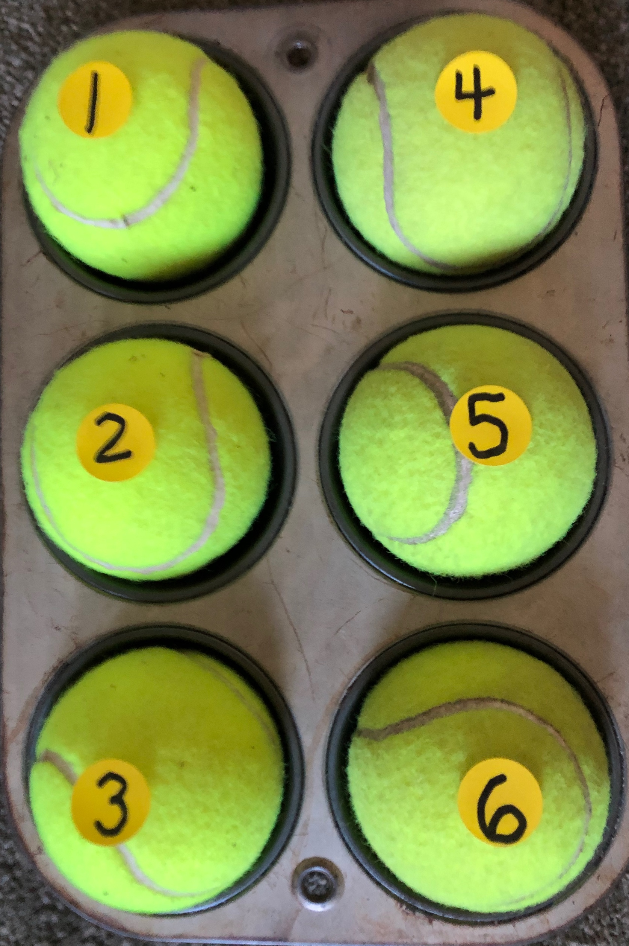
What is a braille cell?
The braille cell is unit of 6 dots, and each letter or character in the braille code is based on a combination or arrangement of those dots.
The raised dot array is set in two parallel columns, with each column having 3 dots.
For ease of explanation, the dots have a numbered position in the braille cell.
The photo shows a 6 cup muffin tin with 6 numbered tennis balls. The muffin tin is positioned in a portrait mode, with the long edge on the sides It represents a braille cell.
Notes:
. The balls or dots on the left sided of the cell are numbered 1 – 3, with 1 being in the top left left, 2 in the middle left and 3 in the bottom left position. The dots on the right are numbered 4-6, with 4 being in the top right, 5 in the middle right and 6 in the bottom right position.

Slide 8
These are mighty dots, they are dynamic and do double duty.
When all 6 dots are raised, we call this a full cell or braille cell. Using a combination of these 6 dots we can create a character that represents a letter, a number, punctuation or even a whole word. All the conventions of print can be represented with the dot matrix.
Something to note: Braille is not a language, but a code. Although we are discussing English braille, these same 6 dots are used when representing other languages such as French, Spanish or Japanese. Or when writing computer code and music.

Slide 9
The first 10 letters of the alphabet: letters a–j
The first 10 letters use the top half of the braille cell.
The four dots on the top part of the cell are dots 1 – 2 on the left and dots 4 – 5 on the right.

Slide 10
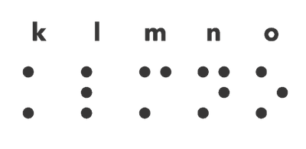
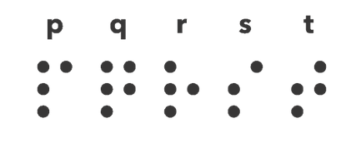
letters k–t
The next 10 letters of the alphabet; letters k – t use the top half of the braille cell and additionally dot 3.

Slide 11
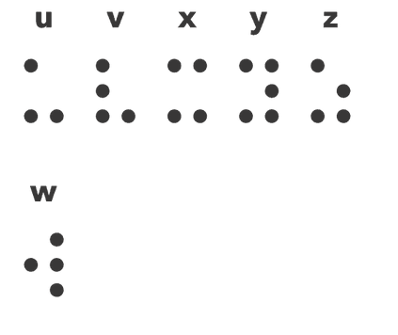
letters u-z
Then letters u through z add into the matrix dot 6
Notes:
There is one letter that does not follow this pattern and that is letter w. As w was not a letter used in the French alphabet when Louis Braille developed the code.

Slide 12
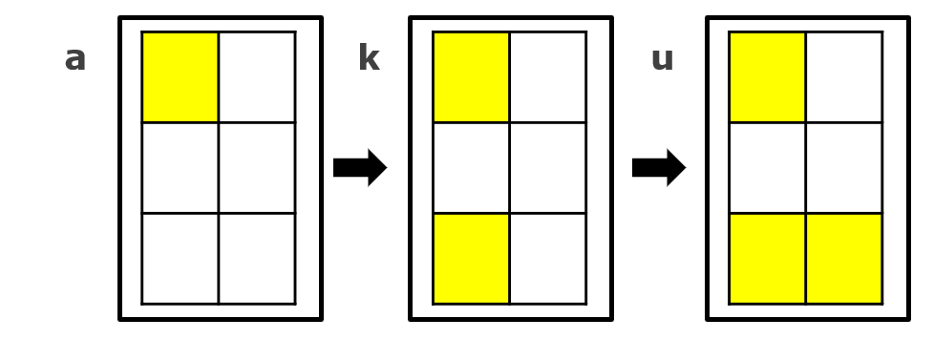
Braille is logical and follows a pattern
For instance, we can start by making the letter a, popping a tennis ball into the upper left top position of the muffin tin, and then we can add another ball into the bottom left position or dot 3 and make letter k, add dot 6 and make letter u.
Notes:
Remember that the first 10 letters use the top half of the braille cell, the next 10 letters add in dot 3 (lower left) and the last letters add, dot 6, lower right.
There is one letter that does not follow this pattern and that is letter w. As w was not a letter used in the French alphabet when Louis Braille developed the code.

Slide 13
Following the pattern (b, l, v)
Notes:
start by making the letter b, popping tennis balls into the upper and middle left top position of the muffin tin, and then we can add another ball into the bottom left position or dot 3 and make letter l, add dot 6 and make letter v.

Slide 14
Following the pattern (c, m, x)
Notes:
Start by making the letter c, popping tennis balls into the upper left and right top position of the muffin tin, and then we can add another ball into the bottom left position or dot 3 and make letter m, add dot 6 and make letter x.
You too, can practice making braille characters using a 6 cup muffin tin with tennis balls, or an egg carton that has been cut in half with some ping pong balls or a dollar store art palette and marbles or ping pong balls.

Slide 15
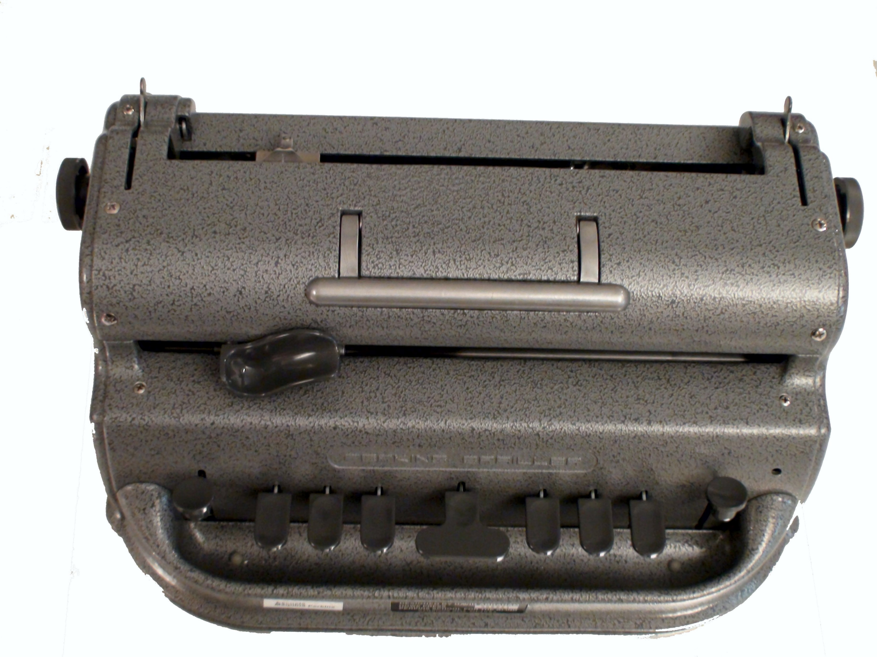
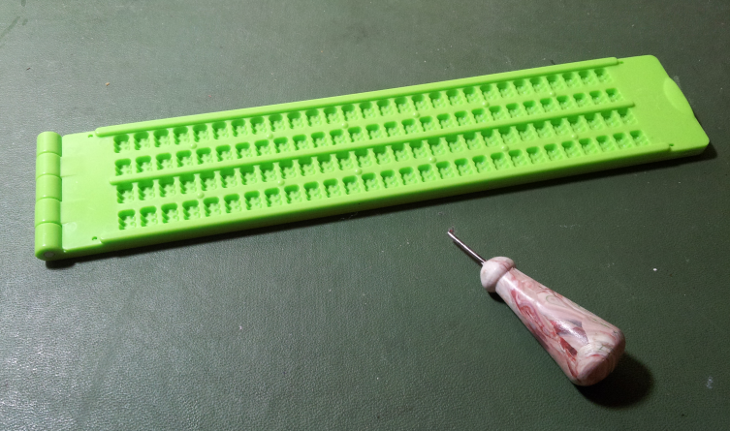
Tools used to write braille
Slate and Stylus
Dymo Braille Labeler
Perkins Brailler
Notes:
These images are not to scale. The braille labeler and stylus used with a slate are hand held. While the Perkins braille is much larger, and is capable of embossing braille onto a sheet of paper 8x11 or 11x11 There are many tools available to write braille. Slates come in different sizes, from a post card size to a full page. And brailler writers can be manual or eletronic

Slide 16
Getting started with braille
Braille Literacy Canada recognizes that learning braille as an adult or older adult can be a challenge. They have created an amazing free program called Braille Zoomers, a monthly virtual peer-support get-together for adult and older adult braille learners.
New Braille Zoomers can even apply for a starter kit of really cool things to get started on their braille journeys. Some of these items would be great to have in libraries too:
Just Enough to Know Better (National Braille Press)
Slate and Stylus
Dymo Braille Labeller
Braille Playing Cards
For more information, email info@blc-lbc.ca

Slide 17
Braille Zoomers Starter Kits
Kit includes:
Dymo braille labeller
Braille playing cards
Braille flashcards
Slate and stylus
Braille eraser
Braille paper
UEB symbols booklet
Just Enough to Know Better (book)
BLC Bookmark and Information on Braille Literacy Canada
Notes:
Photo of a number of items in a braille zoomers starter kit such as a slate and stylus, books, playing cards, labeller,, and paper.

Slide 18
Why Learn Braille?
“Why learn/use print”?
Sight loss: What are you no longer able to do or want to do?
Identifying household items that feel the same or require labels (ex. appliances, cans of soup)
Take notes: phone numbers, messages, route instructions
Play games with sighted and/or blind friends (cards, board games)
Read books with children and/or grandchildren (print-braille books)

Slide 19
Why Learn Braille? (more)
Read and “disconnect”! (magazines, novels, etc.)
Edit texts for school and/or work
Access information difficult to grasp through audio (languages, math, music, images)
Access notes during meetings and presentations
Fill your toolbox! “If you don’t know it, you can’t choose it”.

Slide 20
Dot 1: Let the light in
Braille = symbol of empowerment/independence
Be aware of possible “bumps” and roadblocks:
1. Intimidation: learn what braille is and how it works
Think about other new skills you’ve learned
2. Become aware of misconceptions:
“braille is only for those who are totally blind”: UNTRUE!
“I don’t read novels. Braille isn’t for me”: UNTRUE!
“I’m too old to learn braille”: UNTRUE!
“With technology, there is no need for braille”: UNTRUE!
Replace the word “braille” with “print”

Slide 21
Where to learn braille?
Vision Loss Rehab Canada: www.visionlossrehab.ca
Pacific Training Centre for the Blind: www.pacifictrainingcentre.ca
Lethbridge-Layton-Mackay (QC): www.llmrc.ca
INLB (French, QC): www.inlb.qc.ca
Hadley: www.hadley.edu

Slide 22
Dot 2: Harness the power of technology!
Braille displays connect to computers and smartphones to provide instant access to braille
You can select uncontracted or contracted braille
Firmer bumps are helpful for older learners
Some braille devices also have typing keys
Braille displays are available in different sizes
You can also type braille directly onto your smartphone!

Slide 23
Dot 3: Get to know others
Lifelong braille users: what role braille can play, helpful tips
Fellow learners: to share resources, strategies and to know you’re part of a community!
Braille Zoomers
BLC virtual workshops
CCB “Getting Together With Technology”: www.ccbnational.net
Social media groups (Embracing Braille)
Podcasts: Braillists Foundation

Slide 24
Dot 4: Create a tactile and braille rich environment
Brush up those tactile skills with tactile markers!
Place braille labels all around you!
Practice your braille: recognizing the shapes of different words
Example: A and B can be great labels!

Slide 25
Dot 5: Find meaningful opportunities that make sense to you
Braille is not a language, but you should practice it daily
Not just a tool for the future, but a great tool for today!
Find 10 minutes a day for practice
Read labels in the home
Play bingo, board games and cards with friends
Keep a braille journal
Read familiar stories and quotes

Slide 26
Dot 6: Have fun!
Remember literacy = enjoyment!
Make braille work for you:
Uncontracted or contracted braille?
For “spot reading” or something else?
Recognize your goals may change as you learn more
From elevator buttons to braille bingo… to?!

Slide 27
Family members
Consider learning some braille too!
Hadley: www.hadley.edu
National Braille Press “Just Enough to Know Better” book
BLC workshops for families and friends
Help to create labels using a Dymo labeller
Keep braille in the same place, not under other items
Create braille greeting cards and tags for a personal touch
Ask for braille in the community

Slide 28
Ordering Braille Books and Resources
For Purchasing books:
American Printing House for the Blind
National Braille Press
Seedlings Braille Books for Children
Braille Book Store (note, for personal/home use only)
Additional websites for resources can be found on the Braille Literacy Canada website
Already in Libraries/Available for Borrowing free of charge:
Centre for Equitable Library Access
National Network for Equitable Library Service
Notes:
When starting out with braille, some folks find that it is easier to read braille books that are double space and use uncontracted braille.

Slide 29
About CELA
CELA is a non-profit organization offering more than 1 million accessible titles in a variety of formats including braille.
CELA’s collection also includes magazines and newspapers, as well as access to Bookshare.
Bookshare is a large accessible format collection from the US providing thousands of book titles which can be accessed through CELA’s catalogue for CELA patrons.

Slide 30
CELA’s Braille Offerings
CELA offers a collection of over 11,000 braille titles (books and magazines) for all ages and reading interests
produced in UEB and includes both contracted and uncontracted braille titles
mostly human-transcribed
In addition, Bookshare provides automatically transcribed braille for all epubs and etext files (850,000+ titles).
To access them through CELA, you need Proof of disability.
Physical braille: embossed and mailed in boxes to your home (no need to return)
E-braille: download file or use Direct to Player and then read with a braille display

Slide 31
CELA’s braille and other formats
Print-braille
1,400 picture books for children; all in uncontracted braille.
Print-braille books sent in the mail and need to be returned
Other Formats
Accessing braille material in parallel with other formats can be useful for supporting learning needs.
Other than Braille, the main formats we offer are audio, and accessible e-text. But we can deliver books in these formats in a few different ways.
ZIP and Direct to Player.
CELA’s braille comes from various sources : CNIB Beyond Print braille production, files exchanged through the Marrakesh Treaty between international partners
(we’re excited this now includes titles from NLS!) and French braille titles through exchange with BANQ in Québec.
For those in Québec, French braille can be accessed directly from BANQ.

Slide 32
Accessing Braille from NNELS
Braille can be accessed from NNELS:
Physically through any public library through interlibrary loan
Digitally through https://www.nnels.ca
All of NNELS’ braille titles are human-transcribed and are in either contracted or uncontracted braille and in French or English.
Most of NNELS’ braille titles come from working with publishers to produce new titles at the same time as print publication.
We have poetry, plot-your-own-stories, young adult, adult, fiction, non-fiction, recipes, print-braille, tactile graphics, and more!
All NNELS epub titles can be read on a braille display. Users can request titles for production.
Recommendations for braille display purchases for libraries, or information for readers can be found at: https://nnels.ca/library#Technology
For more information about NNELS' braille and tactile projects, visit https://nnels.ca/braille.

Slide 33
Public Libraries and Braille
Advocacy - Public Libraries and Braille
Public libraries can support their patrons
Libraries may borrow braille titles or download e-braille
Highlight they have access to a braille collection to their community
Encourage that all staff be made aware of the availability of braille content at their library
Create braille signage in the library
Include braille labels on audiobooks and movies (especially those movies with audio description)
Promote access to braille to schools
Include braille activities in programming (Storytime, STEAM etc.)
Run inclusive books clubs
Support adult braille learners
Hire and consult people with lived experience of a disability
Visit accessiblelibraries.ca for learning opportunities

Slide 34
ClosingSlide
On behalf of Braille Literacy Canada, the Canadian Council of the Blind, CNIB Beyond Print, the National Network for Equitable Library Service, Alternate Education Resources Ontario, the Centre for Equitable Library Access, and the Provincial Resource Centre for the Visually Impaired, Thank you for celebrating World Braille Day with us!
We will now stop the recording and allow for a short question and answer period.

Slide 35
Upcoming World Braille Day Events:
Living with braille : Le braille au quotidien* Wednesday, January 18, 2023 10 Pacific / 11 Mountain / 12 Central / 1 Eastern / 2 Atlantic / 2:30 NST
*Please note that this session will be delivered in French only.
Celebrailliation Time! Saturday, January 21, 2023 10 Pacific / 11 Mountain / 12 Central / 1 Eastern / 2 Atlantic / 2:30 NST
Let’s Keep in Touch: Productive Allyship for Braille in Post-Secondary Wednesday, January 25, 2023 10 Pacific / 11 Mountain / 12 Central / 1 Eastern / 2 Atlantic / 2:30 NST

Slide 36
Thank you!
“The invention of braille must be compared to the invention of the printing press – its birth was nothing short of a revolution.” – Helen Keller

